Slide 1
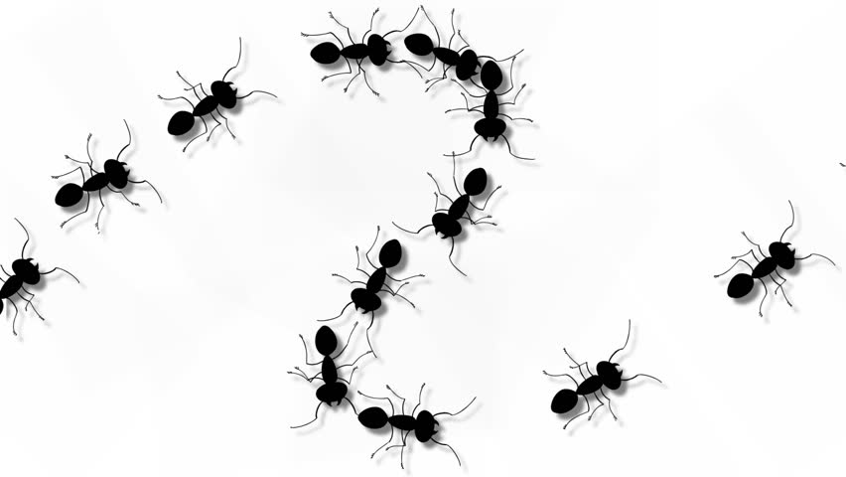
Ants Activity
Click to Begin
Interactive PowerPoint
Template
Aug 2020

Slide 2
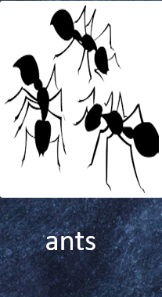
This article described a colony as a group of ___________ ?

Slide 3
Correct!

Slide 4
Try again!

Slide 5
You did it!

